Slide 1
Digital Security and Forensics AICT006-4-2-DSF Version 2
Incidents Respond

Slide 2
Structure of The Lesson & Learning Outcomes
Key Terms You Must Be Able To Use
At the end of this topic, You should be able to:
React
Response
Recover
React
Respond
Recover

Slide 3
Incident Respond
One of the least practiced, most stressful, highly scrutinized areas of Information Security.
Every incident is unique and can incorporate many areas of the affected organization.
Incident analysts must be able to
Think quickly,
Remain calm and
Consider all possibilities

Slide 4
Incident Respond (Cont’d)
The successfulness of a given incident response depends on several factors:
Knowing where to begin,
Gather information and evidences properly and in the correct order, knowing when to request outside assistance.
Therefore, people involved in responding to incidents need to Be Educated in the basic procedures of incident response

Slide 5
Fundamental Concepts
An Incident is any anomaly that violates an organization's security policy.
Incident Response is the timely marshalling (arrangement) of appropriate resources in response to a reported incident or anomaly.
Forensics is the application of scientific knowledge to legal problems.
Computer Forensics is the application of scientific knowledge to legal problems involving computer related evidence.

Slide 6

Fundamental Concepts
REACT
RESPOND
RECOVER

Slide 7
REACT
Review policy and procedures
Evaluate the situation
Avoid panic
Collect information
Take appropriate action

Slide 8
RESPOND
Request information
Evaluate the situation
Stop the “attack” and Secure the “crime scene”
Preserve evidence
Organize forensic examination
Note findings
Determine cause(s)

Slide 9
RECOVER
Raise security expectations
Evaluate current security posture
Create implementation plan
Order it to be done
Validate the implementation
Expect the unexpected
RECOVER on a regular basis

Slide 10


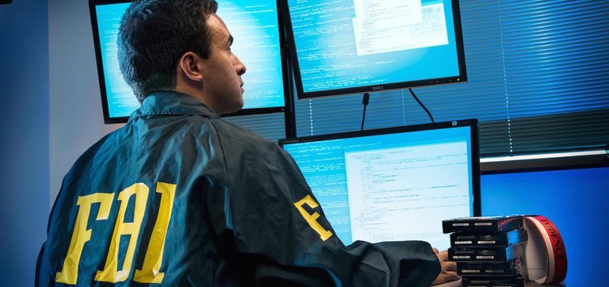
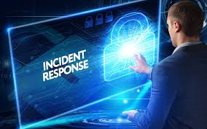
Who Can Help Respond to An Incident?
Incident Response Team (IRT)
Law enforcement
Computer emergency response teams (CERTs)

Slide 11
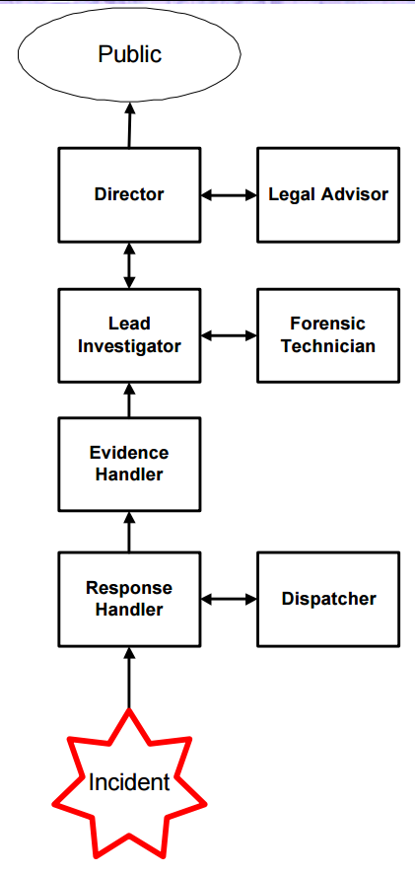
What are the main elements of an incident response team?
Director
Lead Investigator
Forensic Technician(s)
Response Handler
Evidence Handle
Legal Advisor
Notes:
The Director is a person from senior management who has the authority to carry out incident response activities. The Director answers directly to top management (e.g. CEO).
The Lead Investigator is in charge of making sure that incident response activities are executed in the right order and at the right time. The Lead Investigator reports to the Director, and ensures that the technicians and the Evidence and Response Handler have the resources necessary to carry out their duties. The Lead Investigator is responsible for preparing an incident report and briefing any findings and/or determinations to senior management. The Lead Investigator is also responsible for interfacing with law enforcement and other IRTs.
Forensic Technicians carry out incident response tasks at the direction of the Lead Investigator. Forensic Technicians must be experts at what they do. It is likely that more than one technician will be required because different systems and configurations require different skills and knowledge. At a minimum there should be a collective expertise available to the IRT to address all distinct system components involved in the incident. Forensic Technicians are responsible for analyzing that evidence, and reporting on their findings.
The Response Handler is usually the first one on the scene and must react quickly. The responsibilities of the response handler is to secure the crime scene and collect evidence.
The Evidence Handler’s function is to protect all evidence gathered during the course of the incident. This person will receive any evidence that is collected by technicians, ensure that it is properly tagged, check it into and out of protective custody, and maintain a strict chain of custody.
The Legal Adviser’s job is to provide guidance consistent with all applicable state and federal laws. The Legal Adviser is responsible for helping the company decide whether to pursue any kind of legal action.
Dispatchers man the Incident Response hotline. Their responsibilities are to receive distress calls from clients, provide general information about the various incident response services, fill out incident reports, assign tracking numbers to new cases, and connect clients with the appropriate IRT personnel for further assistance. Typically, the dispatch function will be staffed around the clock.

Slide 12
What are the main elements of an incident response team? (Cont’d)
Director
Person from senior management
Has the authority to carry out incident response activities.
Answers and reports directly to top management (e.g. CEO).
Lead Investigator
Makes sure that incident response activities are executed in the right order and at the right time.
Ensures that the technicians and the Evidence and Response Handler have the resources necessary to carry out their duties.
Responsible for preparing an incident report and briefing any findings and/or determinations to senior management.
Also responsible for interfacing with law enforcement and other IRTs.
Reports to the Director
Notes:
The Director is a person from senior management who has the authority to carry out incident response activities. The Director answers directly to top management (e.g. CEO).
The Lead Investigator is in charge of making sure that incident response activities are executed in the right order and at the right time. The Lead Investigator reports to the Director, and ensures that the technicians and the Evidence and Response Handler have the resources necessary to carry out their duties. The Lead Investigator is responsible for preparing an incident report and briefing any findings and/or determinations to senior management. The Lead Investigator is also responsible for interfacing with law enforcement and other IRTs.
Forensic Technicians carry out incident response tasks at the direction of the Lead Investigator. Forensic Technicians must be experts at what they do. It is likely that more than one technician will be required because different systems and configurations require different skills and knowledge. At a minimum there should be a collective expertise available to the IRT to address all distinct system components involved in the incident. Forensic Technicians are responsible for analyzing that evidence, and reporting on their findings.
The Response Handler is usually the first one on the scene and must react quickly. The responsibilities of the response handler is to secure the crime scene and collect evidence.
The Evidence Handler’s function is to protect all evidence gathered during the course of the incident. This person will receive any evidence that is collected by technicians, ensure that it is properly tagged, check it into and out of protective custody, and maintain a strict chain of custody.
The Legal Adviser’s job is to provide guidance consistent with all applicable state and federal laws. The Legal Adviser is responsible for helping the company decide whether to pursue any kind of legal action.
Dispatchers man the Incident Response hotline. Their responsibilities are to receive distress calls from clients, provide general information about the various incident response services, fill out incident reports, assign tracking numbers to new cases, and connect clients with the appropriate IRT personnel for further assistance. Typically, the dispatch function will be staffed around the clock.

Slide 13
What are the main elements of an incident response team? (Cont’d)
Forensic Technicians
Carry's out incident response tasks at the direction of the Lead Investigator.
Must be experts at what they do. It is likely that more than one technician will be required because different systems and configurations require different skills and knowledge.
Are responsible for analyzing that evidence, and reporting on their findings.
Response Handler
Usually the first one on the scene and must react quickly.
The responsibilities of the response handler is to secure the crime scene and collect evidence.
Notes:
The Director is a person from senior management who has the authority to carry out incident response activities. The Director answers directly to top management (e.g. CEO).
The Lead Investigator is in charge of making sure that incident response activities are executed in the right order and at the right time. The Lead Investigator reports to the Director, and ensures that the technicians and the Evidence and Response Handler have the resources necessary to carry out their duties. The Lead Investigator is responsible for preparing an incident report and briefing any findings and/or determinations to senior management. The Lead Investigator is also responsible for interfacing with law enforcement and other IRTs.
Forensic Technicians carry out incident response tasks at the direction of the Lead Investigator. Forensic Technicians must be experts at what they do. It is likely that more than one technician will be required because different systems and configurations require different skills and knowledge. At a minimum there should be a collective expertise available to the IRT to address all distinct system components involved in the incident. Forensic Technicians are responsible for analyzing that evidence, and reporting on their findings.
The Response Handler is usually the first one on the scene and must react quickly. The responsibilities of the response handler is to secure the crime scene and collect evidence.
The Evidence Handler’s function is to protect all evidence gathered during the course of the incident. This person will receive any evidence that is collected by technicians, ensure that it is properly tagged, check it into and out of protective custody, and maintain a strict chain of custody.
The Legal Adviser’s job is to provide guidance consistent with all applicable state and federal laws. The Legal Adviser is responsible for helping the company decide whether to pursue any kind of legal action.
Dispatchers man the Incident Response hotline. Their responsibilities are to receive distress calls from clients, provide general information about the various incident response services, fill out incident reports, assign tracking numbers to new cases, and connect clients with the appropriate IRT personnel for further assistance. Typically, the dispatch function will be staffed around the clock.

Slide 14
What are the main elements of an incident response team? (Cont’d)
Evidence Handler’s
Function is to protect all evidence gathered during the course of the incident.
This person will receive any evidence that is collected by technicians, ensure that it is properly tagged, check it into and out of protective custody, and maintain a strict chain of custody.
Legal Adviser’s
Job is to provide guidance consistent with all applicable state and federal laws.
Is responsible for helping the company decide whether to pursue any kind of legal action.
Notes:
The Director is a person from senior management who has the authority to carry out incident response activities. The Director answers directly to top management (e.g. CEO).
The Lead Investigator is in charge of making sure that incident response activities are executed in the right order and at the right time. The Lead Investigator reports to the Director, and ensures that the technicians and the Evidence and Response Handler have the resources necessary to carry out their duties. The Lead Investigator is responsible for preparing an incident report and briefing any findings and/or determinations to senior management. The Lead Investigator is also responsible for interfacing with law enforcement and other IRTs.
Forensic Technicians carry out incident response tasks at the direction of the Lead Investigator. Forensic Technicians must be experts at what they do. It is likely that more than one technician will be required because different systems and configurations require different skills and knowledge. At a minimum there should be a collective expertise available to the IRT to address all distinct system components involved in the incident. Forensic Technicians are responsible for analyzing that evidence, and reporting on their findings.
The Response Handler is usually the first one on the scene and must react quickly. The responsibilities of the response handler is to secure the crime scene and collect evidence.
The Evidence Handler’s function is to protect all evidence gathered during the course of the incident. This person will receive any evidence that is collected by technicians, ensure that it is properly tagged, check it into and out of protective custody, and maintain a strict chain of custody.
The Legal Adviser’s job is to provide guidance consistent with all applicable state and federal laws. The Legal Adviser is responsible for helping the company decide whether to pursue any kind of legal action.
Dispatchers man the Incident Response hotline. Their responsibilities are to receive distress calls from clients, provide general information about the various incident response services, fill out incident reports, assign tracking numbers to new cases, and connect clients with the appropriate IRT personnel for further assistance. Typically, the dispatch function will be staffed around the clock.

Slide 15
What are the main elements of an incident response team? (Cont’d)
Dispatchers man The Incident Response hotline.
Their responsibilities are to :-
Receive distress calls from clients
Provide general information about the various incident response services
Fill out incident reports
Assign tracking numbers to new cases
and connect clients with the appropriate IRT personnel for further assistance.
Notes:
The Director is a person from senior management who has the authority to carry out incident response activities. The Director answers directly to top management (e.g. CEO).
The Lead Investigator is in charge of making sure that incident response activities are executed in the right order and at the right time. The Lead Investigator reports to the Director, and ensures that the technicians and the Evidence and Response Handler have the resources necessary to carry out their duties. The Lead Investigator is responsible for preparing an incident report and briefing any findings and/or determinations to senior management. The Lead Investigator is also responsible for interfacing with law enforcement and other IRTs.
Forensic Technicians carry out incident response tasks at the direction of the Lead Investigator. Forensic Technicians must be experts at what they do. It is likely that more than one technician will be required because different systems and configurations require different skills and knowledge. At a minimum there should be a collective expertise available to the IRT to address all distinct system components involved in the incident. Forensic Technicians are responsible for analyzing that evidence, and reporting on their findings.
The Response Handler is usually the first one on the scene and must react quickly. The responsibilities of the response handler is to secure the crime scene and collect evidence.
The Evidence Handler’s function is to protect all evidence gathered during the course of the incident. This person will receive any evidence that is collected by technicians, ensure that it is properly tagged, check it into and out of protective custody, and maintain a strict chain of custody.
The Legal Adviser’s job is to provide guidance consistent with all applicable state and federal laws. The Legal Adviser is responsible for helping the company decide whether to pursue any kind of legal action.
Dispatchers man the Incident Response hotline. Their responsibilities are to receive distress calls from clients, provide general information about the various incident response services, fill out incident reports, assign tracking numbers to new cases, and connect clients with the appropriate IRT personnel for further assistance. Typically, the dispatch function will be staffed around the clock.

Slide 16

Common Incident Type
Economic Espionage
Intellectual Property Theft
Unauthorized Access
Stolen Passwords and Data
Unauthorized Use
Inappropriate E-Mail and Web Habits
Malicious Code
Worms with Backdoors (Sasser)
Insider Threats
https://www.voanews.com/usa/us-cracks-down-chinese-economic-espionage
Notes:
The Director is a person from senior management who has the authority to carry out incident response activities. The Director answers directly to top management (e.g. CEO).
The Lead Investigator is in charge of making sure that incident response activities are executed in the right order and at the right time. The Lead Investigator reports to the Director, and ensures that the technicians and the Evidence and Response Handler have the resources necessary to carry out their duties. The Lead Investigator is responsible for preparing an incident report and briefing any findings and/or determinations to senior management. The Lead Investigator is also responsible for interfacing with law enforcement and other IRTs.
Forensic Technicians carry out incident response tasks at the direction of the Lead Investigator. Forensic Technicians must be experts at what they do. It is likely that more than one technician will be required because different systems and configurations require different skills and knowledge. At a minimum there should be a collective expertise available to the IRT to address all distinct system components involved in the incident. Forensic Technicians are responsible for analyzing that evidence, and reporting on their findings.
The Response Handler is usually the first one on the scene and must react quickly. The responsibilities of the response handler is to secure the crime scene and collect evidence.
The Evidence Handler’s function is to protect all evidence gathered during the course of the incident. This person will receive any evidence that is collected by technicians, ensure that it is properly tagged, check it into and out of protective custody, and maintain a strict chain of custody.
The Legal Adviser’s job is to provide guidance consistent with all applicable state and federal laws. The Legal Adviser is responsible for helping the company decide whether to pursue any kind of legal action.
Dispatchers man the Incident Response hotline. Their responsibilities are to receive distress calls from clients, provide general information about the various incident response services, fill out incident reports, assign tracking numbers to new cases, and connect clients with the appropriate IRT personnel for further assistance. Typically, the dispatch function will be staffed around the clock.

Slide 17
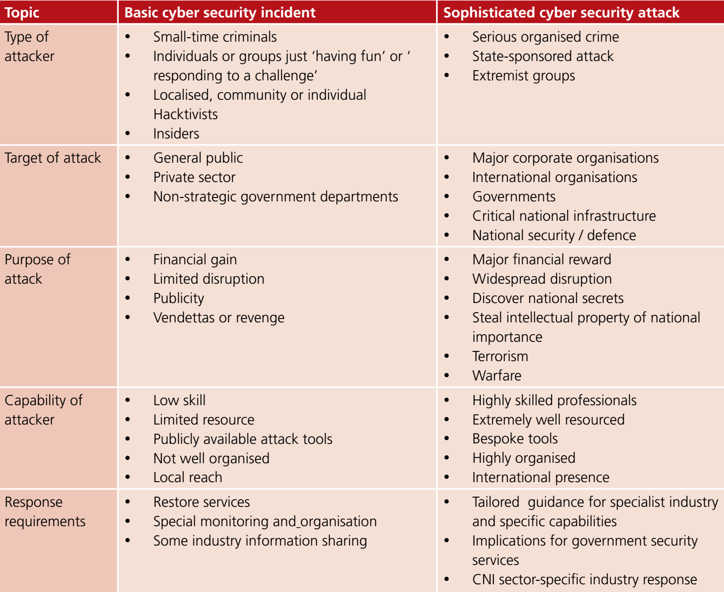
Comparing Different Types of Cyber Security Incident

Slide 18
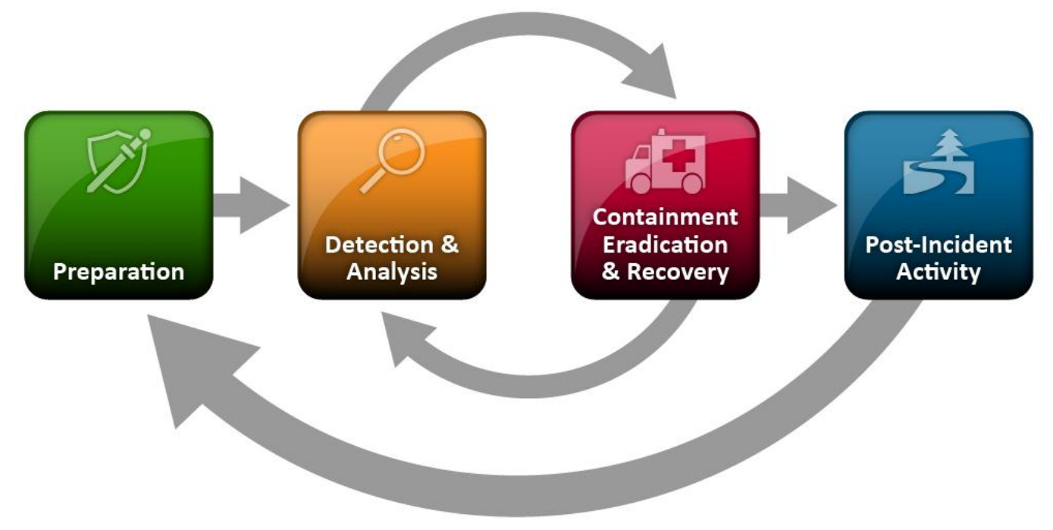
Incident Response Phases (Life Cycle)
Notes:
During preparation, the organization attempts to limit the number of incidents that will occur by selecting and implementing
a set of controls based on the results of risk assessments.
Detection of security breaches is thus necessary to alert the organization
whenever incidents occur. In keeping with the severity of the incident, the organization can mitigate the
impact of the incident by containing it and ultimately recovering from it.
During this phase, activity often cycles back to detection and analysis—for example, to see if additional hosts are infected by malware
while eradicating a malware incident. After the incident is adequately handled, the organization issues a
report that details the cause and cost of the incident and the steps the organization should take to prevent
future incidents.

Slide 19
Preparation
The key to a successful response is Preparation.
Form a Strategy.
Design a Procedure.
Gather Resources.
Practice, practice, practice.
Set security control
Risk Assessment

Slide 20
Preparation: Preparing to Handle Incidents
The lists below provide examples of tools and resources available that may be of value during incident handling:
Incident Handler Communications and Facilities (Contact info of team members and Law enforcement Agency, On-call info, issue tracking system, smartphones carried by team for off-hour support, encryption SW, secure storage facility)
Incident Analysis Hardware and Software (Digital Forensic Workstation21, Backup devices to create disks and preserve log files, laptops, servers, etc.)
Incident Analysis Resources (cryptography hashes of critical files, current baseline of expected network, system and application security)
Incident Mitigation Software (Access to clean OS application for restoration and recovery)
Notes:
Incident Handler Communications and Facilities: Contact information for team members and others within and outside the organization (primary and backup contacts), such as law enforcement and other incident response teams; information may include phone numbers, email addresses, public encryption keys (in accordance with the encryption software described below), and instructions for verifying the contact’s identity  On-call information for other teams within the organization, including escalation information  Incident reporting mechanisms, such as phone numbers, email addresses, online forms, and secure instant messaging systems that users can use to report suspected incidents; at least one mechanism should permit people to report incidents anonymously  Issue tracking system for tracking incident information, status, etc.  Smartphones to be carried by team members for off-hour support and onsite communications  Encryption software to be used for communications among team members, within the organization and with external parties; for Federal agencies, software must use a FIPS-validated encryption algorithm20  War room for central communication and coordination; if a permanent war room is not necessary or practical, the team should create a procedure for procuring a temporary war room when needed  Secure storage facility for securing evidence and other sensitive materials
Incident Analysis Hardware and Software:  Digital forensic workstations21 and/or backup devices to create disk images, preserve log files, and save other relevant incident data  Laptops for activities such as analyzing data, sniffing packets, and writing reports  Spare workstations, servers, and networking equipment, or the virtualized equivalents, which may be used for many purposes, such as restoring backups and trying out malware  Blank removable media  Portable printer to print copies of log files and other evidence from non-networked systems  Packet sniffers and protocol analyzers to capture and analyze network traffic  Digital forensic software to analyze disk images  Removable media with trusted versions of programs to be used to gather evidence from systems  Evidence gathering accessories, including hard-bound notebooks, digital cameras, audio recorders, chain of custody forms, evidence storage bags and tags, and evidence tape, to preserve evidence for possible legal actions
Incident Analysis Resources:  Port lists, including commonly used ports and Trojan horse ports  Documentation for OSs, applications, protocols, and intrusion detection and antivirus products  Network diagrams and lists of critical assets, such as database servers  Current baselines of expected network, system, and application activity  Cryptographic hashes of critical files22 to speed incident analysis, verification, and eradication
Incident Mitigation Software:  Access to images of clean OS and application installations for restoration and recovery purposes Many incident response teams create a jump kit, which is a portable case that contains materials that may be needed during an investigation. The jump kit should be ready to go at all times. Jump kits contain many of the same items listed in the bulleted lists above. For example, each jump kit typically includes a laptop, loaded with appropriate software (e.g., packet sniffers, digital forensics). Other important materials include backup devices, blank media, and basic networking equipment and cables. Because the purpose of having a jump kit is to facilitate faster responses, the team should avoid borrowing items from the jump kit. Each incident handler should have access to at least two computing devices (e.g., laptops). One, such as the one from the jump kit, should be used to perform packet sniffing, malware analysis, and all other actions that risk contaminating the laptop that performs them. This laptop should be scrubbed and all software reinstalled before it is used for another incident. Note that because this laptop is special purpose, it is likely to use software other than the standard enterprise tools and configurations, and whenever possible the incident handlers should be allowed to specify basic technical requirements for these special purpose investigative laptops.
In addition to an investigative laptop, each incident handler should also have a standard laptop, smart phone, or other computing device for writing reports, reading email, and performing other duties unrelated to the hands-on incident analysis.

Slide 21
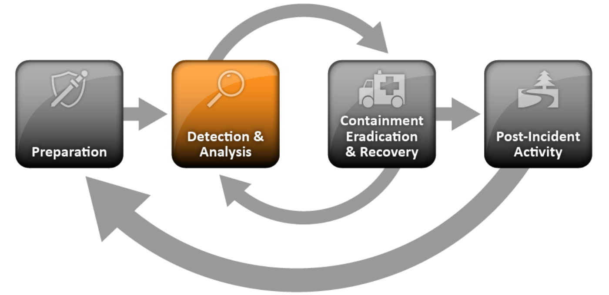
Preparation: Preparing to Handle Incidents
Notes:
Incident Handler Communications and Facilities: Contact information for team members and others within and outside the organization (primary and backup contacts), such as law enforcement and other incident response teams; information may include phone numbers, email addresses, public encryption keys (in accordance with the encryption software described below), and instructions for verifying the contact’s identity  On-call information for other teams within the organization, including escalation information  Incident reporting mechanisms, such as phone numbers, email addresses, online forms, and secure instant messaging systems that users can use to report suspected incidents; at least one mechanism should permit people to report incidents anonymously  Issue tracking system for tracking incident information, status, etc.  Smartphones to be carried by team members for off-hour support and onsite communications  Encryption software to be used for communications among team members, within the organization and with external parties; for Federal agencies, software must use a FIPS-validated encryption algorithm20  War room for central communication and coordination; if a permanent war room is not necessary or practical, the team should create a procedure for procuring a temporary war room when needed  Secure storage facility for securing evidence and other sensitive materials
Incident Analysis Hardware and Software:  Digital forensic workstations21 and/or backup devices to create disk images, preserve log files, and save other relevant incident data  Laptops for activities such as analyzing data, sniffing packets, and writing reports  Spare workstations, servers, and networking equipment, or the virtualized equivalents, which may be used for many purposes, such as restoring backups and trying out malware  Blank removable media  Portable printer to print copies of log files and other evidence from non-networked systems  Packet sniffers and protocol analyzers to capture and analyze network traffic  Digital forensic software to analyze disk images  Removable media with trusted versions of programs to be used to gather evidence from systems  Evidence gathering accessories, including hard-bound notebooks, digital cameras, audio recorders, chain of custody forms, evidence storage bags and tags, and evidence tape, to preserve evidence for possible legal actions
Incident Analysis Resources:  Port lists, including commonly used ports and Trojan horse ports  Documentation for OSs, applications, protocols, and intrusion detection and antivirus products  Network diagrams and lists of critical assets, such as database servers  Current baselines of expected network, system, and application activity  Cryptographic hashes of critical files22 to speed incident analysis, verification, and eradication
Incident Mitigation Software:  Access to images of clean OS and application installations for restoration and recovery purposes Many incident response teams create a jump kit, which is a portable case that contains materials that may be needed during an investigation. The jump kit should be ready to go at all times. Jump kits contain many of the same items listed in the bulleted lists above. For example, each jump kit typically includes a laptop, loaded with appropriate software (e.g., packet sniffers, digital forensics). Other important materials include backup devices, blank media, and basic networking equipment and cables. Because the purpose of having a jump kit is to facilitate faster responses, the team should avoid borrowing items from the jump kit. Each incident handler should have access to at least two computing devices (e.g., laptops). One, such as the one from the jump kit, should be used to perform packet sniffing, malware analysis, and all other actions that risk contaminating the laptop that performs them. This laptop should be scrubbed and all software reinstalled before it is used for another incident. Note that because this laptop is special purpose, it is likely to use software other than the standard enterprise tools and configurations, and whenever possible the incident handlers should be allowed to specify basic technical requirements for these special purpose investigative laptops.
In addition to an investigative laptop, each incident handler should also have a standard laptop, smart phone, or other computing device for writing reports, reading email, and performing other duties unrelated to the hands-on incident analysis.

Slide 22
Detection and Analysis
“Incidents can’t always be prevented, but must always be detected.”

Slide 23
Detection and Analysis: Attack Vectors
Incidents can occur in countless ways, so it is infeasible to develop step-by-step instructions for handling every incident.
Common attack vectors:
External/Removable Media (USB flash drive)
Web
Email
Impersonation (spoofing, man in the middle attacks, rogue wireless access points)
Loss or Theft of Equipment
Other
Notes:
Organizations should be generally prepared to handle any incident but should focus on being prepared to handle incidents that use common attack vectors
External/Removable Media: An attack executed from removable media or a peripheral device—for example, malicious code spreading onto a system from an infected USB flash drive.  Attrition: An attack that employs brute force methods to compromise, degrade, or destroy systems, networks, or services (e.g., a DDoS intended to impair or deny access to a service or application; a brute force attack against an authentication mechanism, such as passwords, CAPTCHAS, or digital signatures).  Web: An attack executed from a website or web-based application—for example, a cross-site scripting attack used to steal credentials or a redirect to a site that exploits a browser vulnerability and installs malware.  Email: An attack executed via an email message or attachment—for example, exploit code disguised as an attached document or a link to a malicious website in the body of an email message.  Impersonation: An attack involving replacement of something benign with something malicious— for example, spoofing, man in the middle attacks, rogue wireless access points, and SQL injection attacks all involve impersonation.  Improper Usage: Any incident resulting from violation of an organization’s acceptable usage policies by an authorized user, excluding the above categories; for example, a user installs file sharing software, leading to the loss of sensitive data; or a user performs illegal activities on a system.
Loss or Theft of Equipment: The loss or theft of a computing device or media used by the organization, such as a laptop, smartphone, or authentication token.  Other: An attack that does not fit into any of the other categories.

Slide 24
Common Attack Vectors
External/Removable Media: An attack executed from removable media or a peripheral device—for example, malicious code spreading onto a system from an infected USB flash drive.
Attrition: An attack that employs brute force methods to compromise, degrade, or destroy systems, networks, or services (e.g. a brute force attack against an authentication mechanism, such as passwords, CAPTCHAS, or digital signatures).

Slide 25
Common Attack Vectors
Web: An attack executed from a website or web-based application—for example, a cross-site scripting attack used to steal credentials or a redirect to a site that exploits a browser vulnerability and installs malware.
Email: An attack executed via an email message or attachment—for example, exploit code disguised as an attached document or a link to a malicious website in the body of an email message.
Impersonation: An attack involving replacement of something benign with something malicious— for example, spoofing, man in the middle attacks, rogue wireless access points, and SQL injection attacks all involve impersonation.

Slide 26
Common Attack Vectors
Improper Usage: Any incident resulting from violation of an organization’s acceptable usage policies by an authorized user, excluding the above categories; for example, a user installs file sharing software, leading to the loss of sensitive data; or a user performs illegal activities on a system.
Loss or Theft of Equipment: The loss or theft of a computing device or media used by the organization, such as a laptop, smartphone, or authentication token.
Other: An attack that does not fit into any of the other categories.

Slide 27

Detection and Analysis: Signs of an Incident
For many organizations, the most challenging part of the incident response process is accurately Detecting and assessing possible incidents.
Notes:
Most attacks do not have any identifiable or detectable precursors from the target’s perspective. If
precursors are detected, the organization may have an opportunity to prevent the incident by altering its
security posture to save a target from attack. At a minimum, the organization could monitor activity
involving the target more closely.

Slide 28
Detection and Analysis: Signs of an Incident
Signs of an incident
Precursors: a sign that an incident may occur in the future
Indicators: a sign that an incident may have occurred or may be occurring now
Notes:
Most attacks do not have any identifiable or detectable precursors from the target’s perspective. If
precursors are detected, the organization may have an opportunity to prevent the incident by altering its
security posture to save a target from attack. At a minimum, the organization could monitor activity
involving the target more closely.

Slide 29
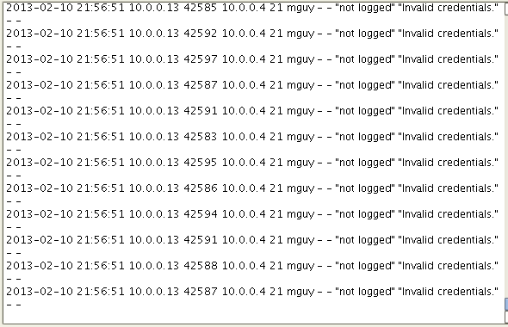
Detection and Analysis: Signs of an Incident
Examples of precursors are:
Web server log entries that show the usage of a vulnerability scanner
An announcement of a new exploit that targets a vulnerability of the organization’s mail server
A threat from a group stating that the group will attack the organization.
Notes:
Most attacks do not have any identifiable or detectable precursors from the target’s perspective. If
precursors are detected, the organization may have an opportunity to prevent the incident by altering its
security posture to save a target from attack. At a minimum, the organization could monitor activity
involving the target more closely.

Slide 30

Detection and Analysis: Signs of an Incident
Examples of Indicators are:
A network intrusion detection sensor alerts when a successful attack occurs against a database server.
Antivirus software alerts when it detects that a host is infected with malware.
http://devco.re/blog/2016/04/21/how-I-hacked-facebook-and-found-someones-backdoor-script-eng-ver/

Slide 31
Detection and Analysis: Incident Analysis
Performing the initial analysis and validation is challenging. The following are recommendations for making incident analysis easier and more effective:
Profile Networks and Systems.
Understand Normal Behaviors
Create a Log Retention Policy
Perform Event Correlation
Keep All Host Clocks Synchronized
Maintain and Use a Knowledge Base of Information
Run Packet Sniffers to Collect Additional Data
Filter the Data
Notes:
When the team believes that an incident has occurred, the team should rapidly perform an initial analysis to determine the incident’s scope, such as which networks, systems, or applications are affected; who or what originated the incident; and how the incident is occurring (e.g., what tools or attack methods are being used, what vulnerabilities are being exploited). The initial analysis should provide enough information for the team to prioritize subsequent activities, such as containment of the incident and deeper analysis of the effects of the incident.
Create a Log Retention Policy. Information regarding an incident may be recorded in several places, such as firewall, IDPS, and application logs. Creating and implementing a log retention policy that specifies how long log data should be maintained may be extremely helpful in analysis because older log entries may show reconnaissance activity or previous instances of similar attacks. Another reason for retaining logs is that incidents may not be discovered until days, weeks, or even months later. The length of time to maintain log data is dependent on several factors, including the organization’s data retention policies and the volume of data. See NIST SP 800-92, Guide to Computer Security Log Management for additional recommendations related to logging.34  Perform Event Correlation. Evidence of an incident may be captured in several logs that each contain different types of data—a firewall log may have the source IP address that was used, whereas an application log may contain a username. A network IDPS may detect that an attack was launched against a particular host, but it may not know if the attack was successful. The analyst may need to examine the host’s logs to determine that information. Correlating events among multiple indicator sources can be invaluable in validating whether a particular incident occurred.
Keep All Host Clocks Synchronized. Protocols such as the Network Time Protocol (NTP) synchronize clocks among hosts.35 Event correlation will be more complicated if the devices reporting events have inconsistent clock settings. From an evidentiary standpoint, it is preferable to have consistent timestamps in logs—for example, to have three logs that show an attack occurred at 12:07:01 a.m., rather than logs that list the attack as occurring at 12:07:01, 12:10:35, and 11:07:06.  Maintain and Use a Knowledge Base of Information. The knowledge base should include information that handlers need for referencing quickly during incident analysis. Although it is possible to build a knowledge base with a complex structure, a simple approach can be effective. Text documents, spreadsheets, and relatively simple databases provide effective, flexible, and searchable mechanisms for sharing data among team members. The knowledge base should also contain a variety of information, including explanations of the significance and validity of precursors and indicators, such as IDPS alerts, operating system log entries, and application error codes.  Use Internet Search Engines for Research. Internet search engines can help analysts find information on unusual activity. For example, an analyst may see some unusual connection attempts targeting TCP port 22912. Performing a search on the terms “TCP,” “port,” and “22912” may return some hits that contain logs of similar activity or even an explanation of the significance of the port number. Note that separate workstations should be used for research to minimize the risk to the organization from conducting these searches.  Run Packet Sniffers to Collect Additional Data. Sometimes the indicators do not record enough detail to permit the handler to understand what is occurring. If an incident is occurring over a network, the fastest way to collect the necessary data may be to have a packet sniffer capture network traffic. Configuring the sniffer to record traffic that matches specified criteria should keep the volume of data manageable and minimize the inadvertent capture of other information. Because of privacy concerns, some organizations may require incident handlers to request and receive permission before using packet sniffers.  Filter the Data. There is simply not enough time to review and analyze all the indicators; at minimum the most suspicious activity should be investigated. One effective strategy is to filter out categories of indicators that tend to be insignificant. Another filtering strategy is to show only the categories of indicators that are of the highest significance; however, this approach carries substantial risk because new malicious activity may not fall into one of the chosen indicator categories.

Slide 32
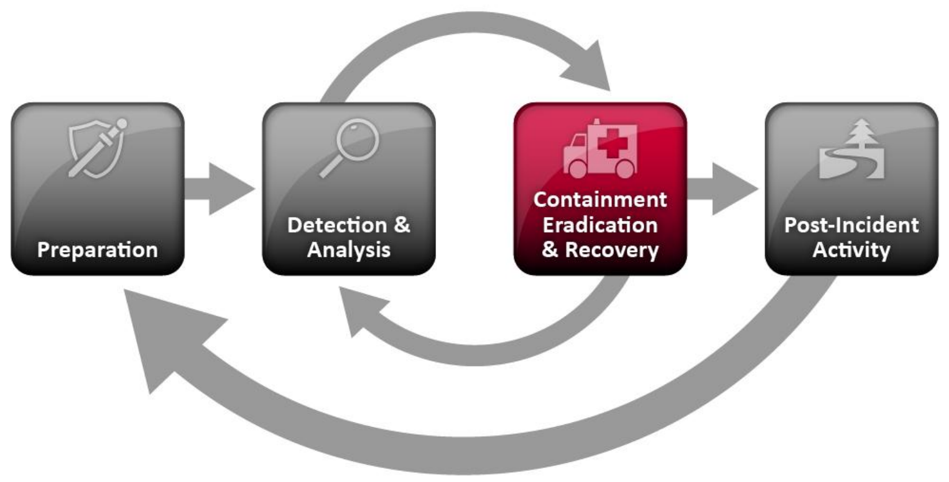
Incident Response Phases (Life Cycle)

Slide 33
Containment, Eradication and Recovery: Choosing a Containment Strategy
Containment is important before an incident overwhelms resources or increases damage.
Containment strategies vary based on the type of incident. Criteria for determining the appropriate strategy include:
Potential damage to and theft of resources
Need for evidence preservation
Service availability (e.g., network connectivity, services provided to external parties)
Time and resources needed to implement the strategy
Effectiveness of the strategy (e.g., partial containment, full containment)
Notes:
An essential part of containment is decision-making (e.g., shut down a system, disconnect it from a network, disable certain functions). Such decisions are much easier to make if there are predetermined strategies and procedures for containing the incident. Organizations should define acceptable risks in dealing with incidents and develop strategies accordingly.
Containment strategies vary based on the type of incident. For example, the strategy for containing an email-borne malware infection is quite different from that of a network-based DDoS attack. Organizations should create separate containment strategies for each major incident type, with criteria documented clearly to facilitate decision-making. In certain cases, some organizations redirect the attacker to a sandbox (a form of containment) so that they can monitor the attacker’s activity, usually to gather additional evidence. The incident response team should discuss this strategy with its legal department to determine if it is feasible. Ways of monitoring an attacker’s activity other than sandboxing should not be used; if an organization knows that a system has been compromised and allows the compromise to continue, it may be liable if the attacker uses the compromised system to attack other systems. The delayed containment strategy is dangerous because an attacker could escalate unauthorized access or compromise other systems.
Another potential issue regarding containment is that some attacks may cause additional damage when they are contained. For example, a compromised host may run a malicious process that pings another host periodically. When the incident handler attempts to contain the incident by disconnecting the compromised host from the network, the subsequent pings will fail. As a result of the failure, the malicious process may overwrite or encrypt all the data on the host’s hard drive. Handlers should not assume that just because a host has been disconnected from the network, further damage to the host has been prevented.

Slide 34
Containment, Eradication and Recovery: Evidence Gathering and Handling
Although the primary reason for gathering evidence during an incident is to resolve the incident, it may also be needed for legal proceedings.
A detailed log should be kept for all evidence, including the following:
Identifying information (e.g., the location, serial number, model number, hostname, media access control (MAC) addresses, and IP addresses of a computer)
Name, title, and phone number of each individual who collected or handled the evidence during the investigation
Time and date (including time zone) of each occurrence of evidence handling
Locations where the evidence was stored.
Notes:
Collecting evidence from computing resources presents some challenges. It is generally desirable to acquire evidence from a system of interest as soon as one suspects that an incident may have occurred. Many incidents cause a dynamic chain of events to occur; an initial system snapshot may do more good in identifying the problem and its source than most other actions that can be taken at this stage. From an evidentiary standpoint, it is much better to get a snapshot of the system as-is rather than doing so after incident handlers, system administrators, and others have inadvertently altered the state of the machine during the investigation.

Slide 35
Containment, Eradication and Recovery: Identifying the Attacking Hosts
The following items describe the most commonly performed activities for attacking host identification:
Validating the Attacking Host’s IP Address.
Researching the Attacking Host through Search Engines.
Using Incident Databases
Monitoring Possible Attacker Communication Channels
Notes:
Validating the Attacking Host’s IP Address. New incident handlers often focus on the attacking host’s IP address. The handler may attempt to validate that the address was not spoofed by verifying connectivity to it; however, this simply indicates that a host at that address does or does not respond to the requests. A failure to respond does not mean the address is not real—for example, a host may be configured to ignore pings and traceroutes. Also, the attacker may have received a dynamic address that has already been reassigned to someone else.  Researching the Attacking Host through Search Engines. Performing an Internet search using the apparent source IP address of an attack may lead to more information on the attack—for example, a mailing list message regarding a similar attack.  Using Incident Databases. Several groups collect and consolidate incident data from various organizations into incident databases. This information sharing may take place in many forms, such as trackers and real-time blacklists. The organization can also check its own knowledge base or issue tracking system for related activity.  Monitoring Possible Attacker Communication Channels. Incident handlers can monitor communication channels that may be used by an attacking host. For example, many bots use IRC as their primary means of communication. Also, attackers may congregate on certain IRC channels to brag about their compromises and share information. However, incident handlers should treat any such information that they acquire only as a potential lead, not as fact.

Slide 36
Containment, Eradication and Recovery: Eradication and Recovery
After an incident has been contained, eradication may be necessary to eliminate components of the incident, such as:
Deleting malware
Disabling breached user accounts
Identifying and mitigating all vulnerabilities that were exploited.
During Eradication, it is important to identify all affected hosts within the organization so that they can be remediated.

Slide 37
Containment, Eradication and Recovery: Eradication and Recovery…
In recovery, administrators restore systems to normal operation, confirm that the systems are functioning normally, and (if applicable) remediate vulnerabilities to prevent similar incidents.
Recovery may involve such actions as
Restoring systems from clean backups,
Rebuilding systems from scratch,
Replacing compromised files with clean versions,
Installing patches,
Changing passwords,
And tightening network perimeter security (e.g., firewall rulesets, boundary router access control lists).
Notes:
Higher levels of system logging or network monitoring are often part of the recovery process. Once a resource is successfully attacked, it is often attacked again, or other resources within the organization are attacked in a similar manner.
Eradication and recovery should be done in a phased approach so that remediation steps are prioritized. For large-scale incidents, recovery may take months; the intent of the early phases should be to increase the overall security with relatively quick (days to weeks) high value changes to prevent future incidents. The later phases should focus on longer-term changes (e.g., infrastructure changes) and ongoing work to keep the enterprise as secure as possible.

Slide 38
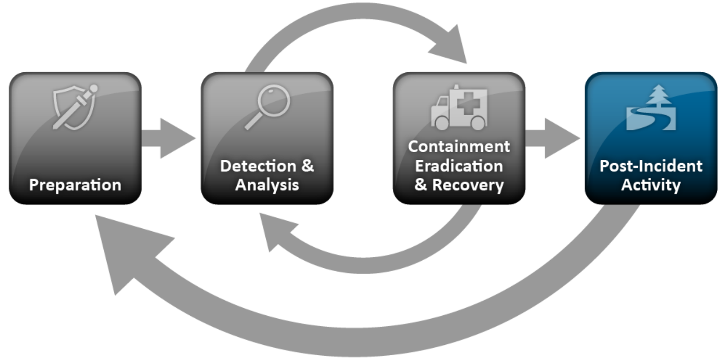
Incident Response Phases (Life Cycle)

Slide 39
Post-Incident: Lessons Learned
One of the most important parts of incident response is also the most often omitted: Learning and Improving.
Multiple incidents can be covered in a single lessons learned meeting.
Questions to be answered in the meeting include:
Exactly what happened, and at what times?
How well did staff and management perform in dealing with the incident?
What information was needed sooner?
What corrective actions can prevent similar incidents in the future?
What precursors or indicators should be watched for in the future to detect similar incidents?
What additional tools or resources are needed to detect, analyze, and mitigate future incidents?
Notes:
Lessons learned meetings provide other benefits. Reports from these meetings are good material for training new team members by showing them how more experienced team members respond to incidents. Updating incident response policies and procedures is another important part of the lessons learned process. Post-mortem analysis of the way an incident was handled will often reveal a missing step or an inaccuracy in a procedure, providing impetus for change. Because of the changing nature of information technology and changes in personnel, the incident response team should review all related documentation and procedures for handling incidents at designated intervals.

Slide 40
Incident Handling Checklist
The checklist in next slide provides the major steps to be performed in the handling of an incident.
Note that the actual steps performed may vary based on the type of incident and the nature of individual incidents.
For example, if the handler knows exactly what has happened based on analysis of indicators (Step 1.1), there may be no need to perform Steps 1.2 or 1.3 to further research the activity.
Notes:
The checklist provides guidelines to handlers on the major steps that should be performed; it does not dictate the exact sequence of steps that should always be followed.

Slide 41
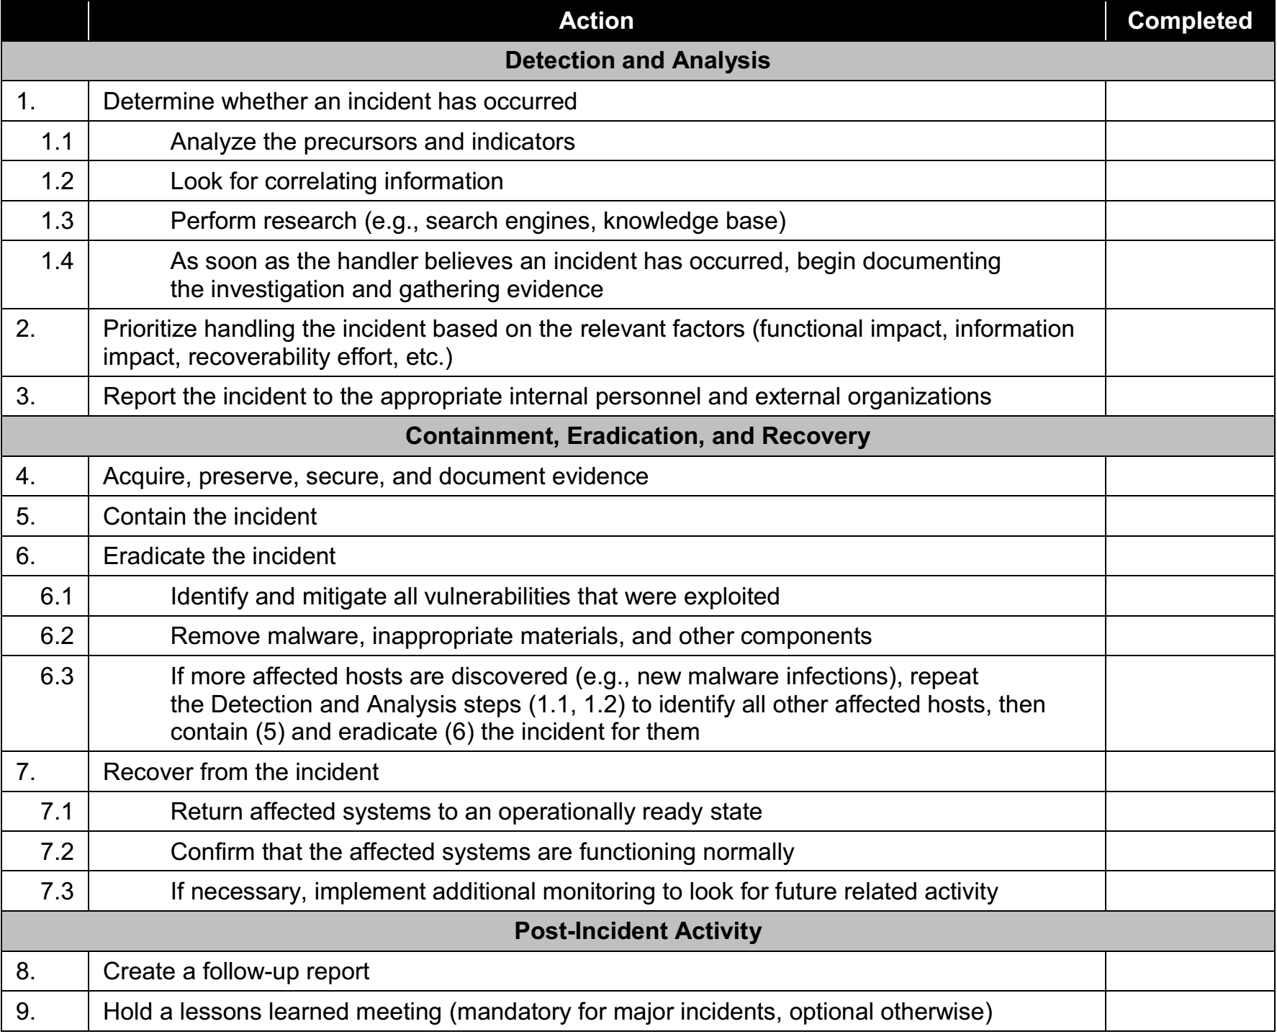

Slide 42
Detection and Analysis: Incident Documentation
Document system events, conversations, and observed changes in files.
Whenever possible, handlers should work in teams of at least two: one person can record and log events while the other person performs the technical tasks.
Notes:
Documenting system events, conversations, and observed changes in files can lead to a more efficient, more systematic, and less error prone handling of the problem.

Slide 43
Detection and Analysis: Incident Documentation…
The incident response team should maintain records about the status of incidents using an application or a database, such as an issue tracking system. The issue tracking system should contain information on the following:
The current status of the incident (new, in progress, forwarded for investigation, resolved, etc.)
A summary of the incident
Indicators related to the incident
Other incidents related to this incident
Actions taken by all incident handlers on this incident
Chain of custody, if applicable
Impact assessments related to the incident
A list of evidence gathered during the incident investigation
Notes:
The incident response team should safeguard incident data and restrict access to it because it often contains sensitive information—for example, data on exploited vulnerabilities, recent security breaches, and users that may have performed inappropriate actions. For example, only authorized personnel should have access to the incident database. Incident communications (e.g., emails) and documents should be encrypted or otherwise protected so that only authorized personnel can read them.

Slide 44
Detection and Analysis: Chain of Custody
Evidence must be accounted for, from the time it is collected until the time it is submitted to the court.
Each piece of evidence must be under the control of one, identifiable person at all times.
A change in control of the evidence must be recorded.
Evidence in storage must be protected from contamination. (ie… sealed and secured)

Slide 45

Detection and Analysis: Chain of Custody…

Slide 46
Quick Review Question
Discuss Incident Response Life Cycle?

Slide 47
Summary of Main Teaching Points
Organizations must create, provision, and operate a formal incident response capability.
Establishing an incident response capability should include the following actions:
Creating an incident response policy and plan Developing procedures for performing incident handling and reporting Setting guidelines for communicating with outside parties regarding incidents Selecting a team structure and staffing model Establishing relationships and lines of communication between the incident response team and other groups, both internal (e.g., legal department) and external (e.g., law enforcement agencies) Determining what services the incident response team should provide
Staffing and training the incident response team

Slide 48
Question and Answer Session
Q & A

